Slide 1


Introducing
Azure Data Catalog
Priya Aswani
Data Solution Architect
Information Management & Machine Learning
Microsoft Azure Data Catalog

Slide 2








Cortana Intelligence Transform data into intelligent action
Information Management
Big Data Stores
Machine Learning and Analytics
Dashboards and Visualizations
Business apps
Power BI
Azure
Data Factory
Azure
Machine Learning
Personal Digital Assistant
Azure
Data Lake Store
Hadoop, Spark, Storm, Hbase Managed Clusters (Azure Data Lake)
Cortana
People
Custom apps
Azure
Data Catalog
Perceptual Intelligence
Azure SQL Data
Warehouse
Azure Data Lake
Analytics
Face, vision
Speech, text
Azure
Event Hub
Azure Stream
Analytics
Business Scenarios
Sensors and devices
Recommendations,
customer churn,
forecasting, etc.
Automated Systems
DATA
INTELLIGENCE
ACTION
Notes:
Cortana Analytics Suite delivers an end-to-end platform with integrated and comprehensive set of tools and services to help you build intelligent applications that let you easily take advantage of Advanced Analytics.
First Cortana Analytics Suite provides services to bring data in, so that you can analyze it. It provides information management capabilities like Azure Data Factory so that you can pull data from any source (relational DB like SQL or non-relational ones like your Hadoop cluster) in an automated and scheduled way, while performing the necessary data transforms (like setting certain data columns as dates vs. currency etc). Think ETL (Extract, Transform, Load) in the cloud. Event hub does the same for IoT type ingestion of data that streams in from lots of end points.
The data brought in then can be persisted in flexible big data storage services like Data Lake and Azure SQL DW.
You can then use a wide range of analytics services from Azure ML to Azure HDInsight to Azure Stream Analytics to analyze the data that are stored in the big data storage. This means you can create analytics services and models specific to your business need (say real time demand forecasting).
The resultant analytics services and models created by taking these steps can then be surfaced as interactive dashboards and visualizations via Power BI
These same analytics services and models created can also be integrated into various different UI (web apps or mobile apps or rich client apps) as well as via integrations with Cortana, so end users can naturally interact with them via speech etc., and so that end users can get proactively be notified by Cortana if the analytics model finds a new anomaly (unusual growth in certain product purchases- in the case of real time demand forecasting example given above) or whatever deserves the attention of the business users.

Slide 3

Recognize Any of These Challenges?
Users spend more time looking for data,
than they do analyzing it
Data is sitting in multiple sources, but no insight into which data sits where
Many different data ecosystems across the enterprise, but no way to share data artifacts across them
Need data consumption in multiple different tools, but no common way of enabling discovery and access to data sources across them
Users are busy re-producing data assets that already exist
No way of tracking usage of our BI and Analytics assets
Notes:
What data is most important to you???!
When (to use it):
There is no central location where data assets are registered.
One lacks trust in documentation - it is often perceived as being out of date
Access: you can understand the process for requesting access, discovering the data asset and its documentation, and yet it still doesn’t allow you to access the data
Users are not aware that data assets exist unless they come into contact with it as part of another process
Connection Issues: Need the connection string or path - You can’t connect to the data using a client app unless you know the location of a data asset
Need to know the location of a data asset's documentation to understand the intended uses of the data
Data and documentation live in different places and are consumed through different experiences.
If you have questions about an information asset, you would need to locate the expert or team responsible for the data and engage those experts offline - there is no explicit connection between data and those with expert perspectives on its use.

Slide 4






Bridging the Gap
Faster time to value
Between IT
and the Business
Notes:
Where (in the org is it used): To Bridge the gap between IT and the business
Why: Faster time to value from enterprise information assets

Slide 5
What is Azure Data Catalog?
An enterprise-wide catalog in Azure that enables self-service discovery of data from any source
A metadata repository that allow users to register, enrich, understand, discover, and consume data sources
Discover
Search
Browse
Filter
Understand
Metadata
Experts
Context
Consume
Your data
Your tools
Your way
Contribute
Tag
Document
Register
Notes:
Garter uses the term “dark data” to describe the data that exists inside an organization, that the organization is not using or is not getting value from.
Tom from finance knows the intersection of this financial data and the business.
Each one of these users has a unique and important perspective on this data and it’s use. We must get inside on the data sources, locations, their structure and their purpose.
System of registration and system of discovery for enterprise data assets.
Allows you to: register, discover, understand, and consume data assets.
Register/Discover:
Metadata only: Data resides where it lives. No need for data movement, no latency-- FAST
Understand:
Powered by annotation crowdsourcing: Empowering any user to capture and share their knowledge about registered sources
Consume: Who: Analysts, data scientists, developers
Consumption through any** tool of your choice
Consumption from any** source: Structured/unstructured, on-prem/in the cloud

Slide 6
Demo
Notes:
Azuredatacatalog.com

Slide 7
How is it Different?
Data source discovery
Data from any source
Metadata only – Data resides where it lives
No need for data movement, No latency
Structured and unstructured
on premises and in the cloud
Consumption through any tool
Powered by annotation crowdsourcing
Enabling publishing, discovery and consumption of data sources through your tool of choice
Empowering any user to capture and share their knowledge about registered sources
Notes:
Extract both descriptive and structural metadata from the data source
We do encrypt data source metadata at rest on the back end, and our REST API uses HTTPS encryption

Slide 8
Publish
What Can I Do With It?
Publisher
Consumer
IT Admin
Discover
Govern
Register Data Sources
Browse - Search
Apply Policies - Control Access
Enrich
Understand
Analyze
Categorize – Annotate
Get context – Identify Intent
Track and monitor usage
Extend
Notes:
What:
An enterprise-wide catalog in Azure that enables self-service discovery of data from any source
A metadata repository that allow users to register, enrich, understand, discover, and consume data sources
Q: Who are the target audiences for Data Catalog?
Data Developers, Data Scientists, BI and Analytics Professionals: Who are responsible for producing data and analytics content for others to consume
Data Stewards: Those who have the knowledge about the data, what it means and how it is intended to be used and for which purpose
Data Consumers: Those who need to be able to easily discover, understand and connect to data needed to do their job using the tool of their choice
Central IT: Those who need to make hundreds of data sources discoverable for the business users, and who need to maintain oversight over how data is being used and by whom

Slide 9
New Capabilities
Added since the service went into Public Preview
New Data sources
SQL DW
Reporting Services
Oracle Database
Teradata
Azure Blobs
HDFS
Hive
Azure Data Lake
SAP HANA
MYSQL
Manual Entry of Data Sources & Schema
Data Profiling
Provisioning in the Azure portal
Request access to data asset
Support for Container
Rich text editor for asset documentation
Open in Power BI and SQL Server Data Tools
Copy Connection strings
Saved Searches
Ability to pin assets
New Landing page optimized for recurring users surfacing basic analytics and one click access to top content
User Profile (supporting recent search terms)
Support for Security Groups
Enriched Query Language
Notes:
Use Case: Enhance Chevron’s ETL flows to register newly created items in the catalog.
Roadmap: We are planning support for SSIS packages in Azure Data Catalog, but (as with lineage in general) the details and timeline are still TBD.
Cloud First :
I remember it took more than a year to Cloudera to make Navigator compatible with alternate external filesystem like EMC Isilon (which is onprem what ADLS is in PaaS), because of the hooks to implement for metadata and lineage.

Slide 10
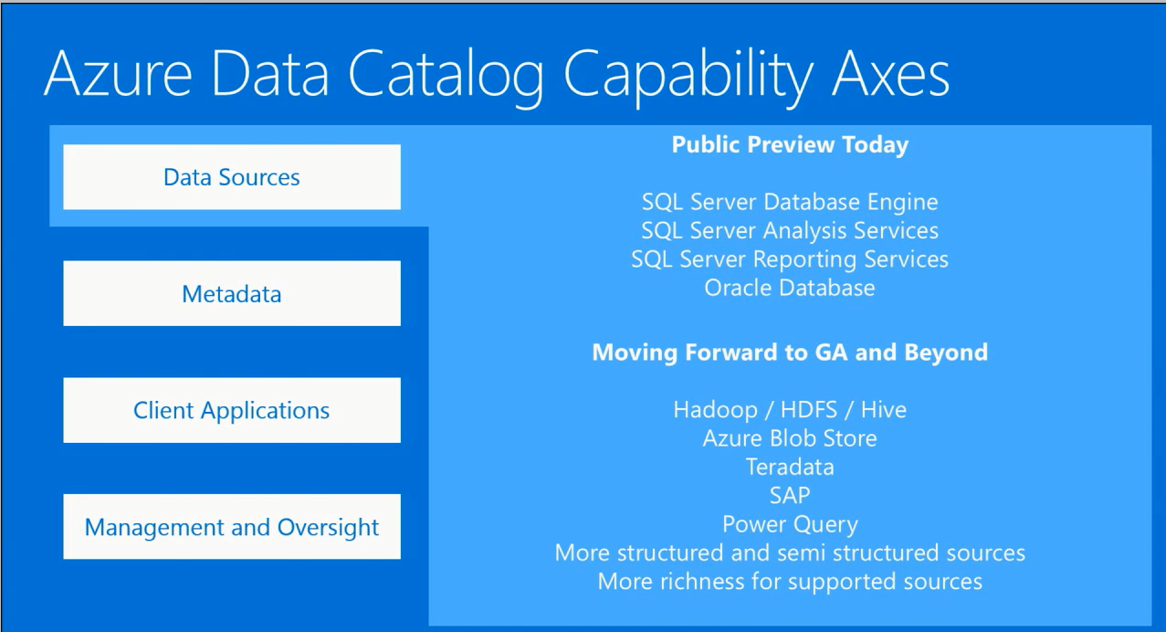

Slide 11
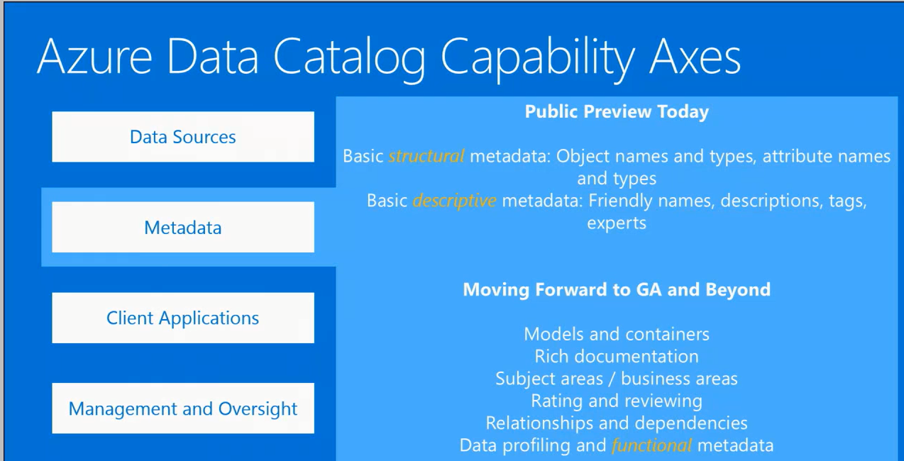
Notes:
Also AML – we recommend xyz for you
Automation – users do least amount of heavy lifting

Slide 12
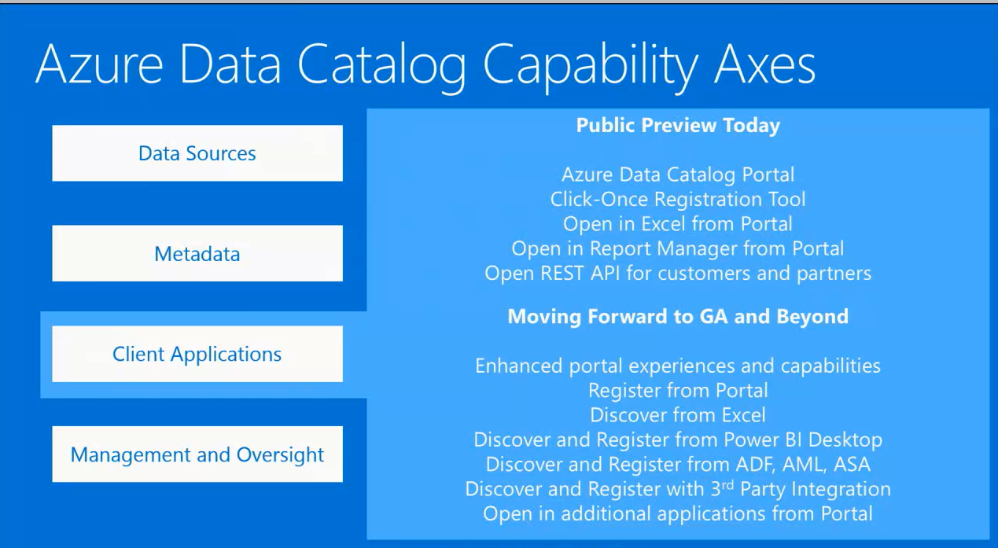

Slide 13
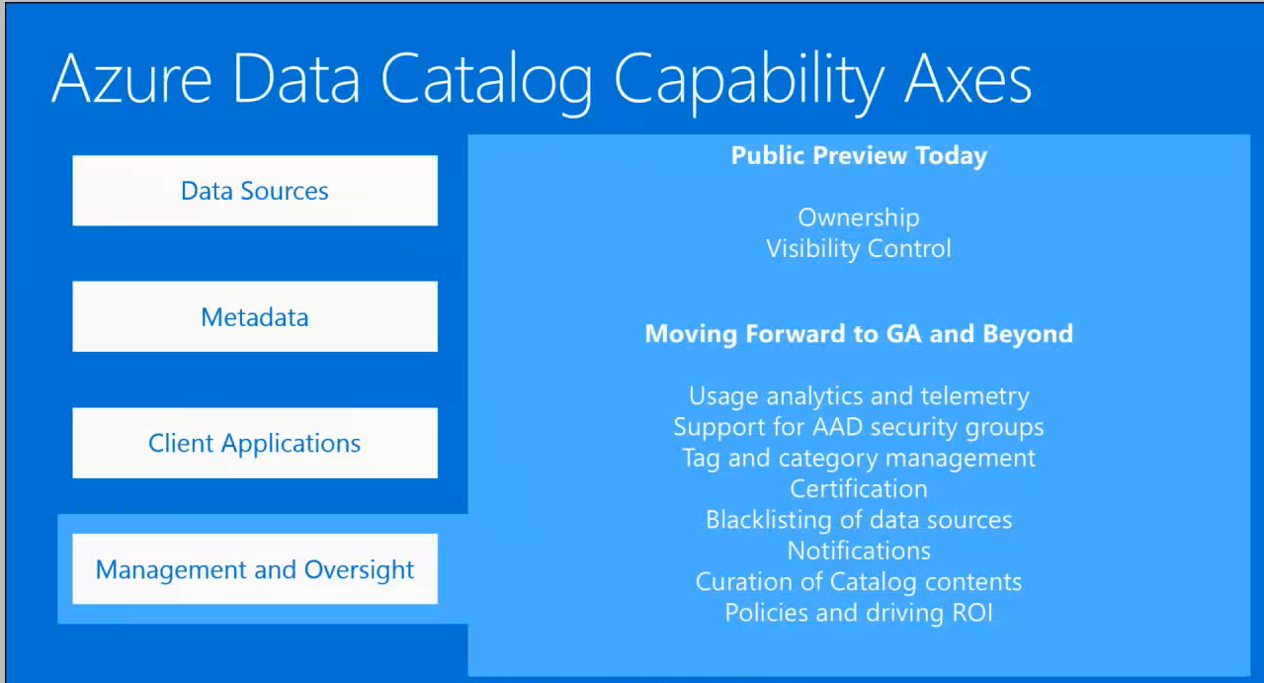
Notes:
SHADOW IT

Slide 14
Appendix

Slide 15
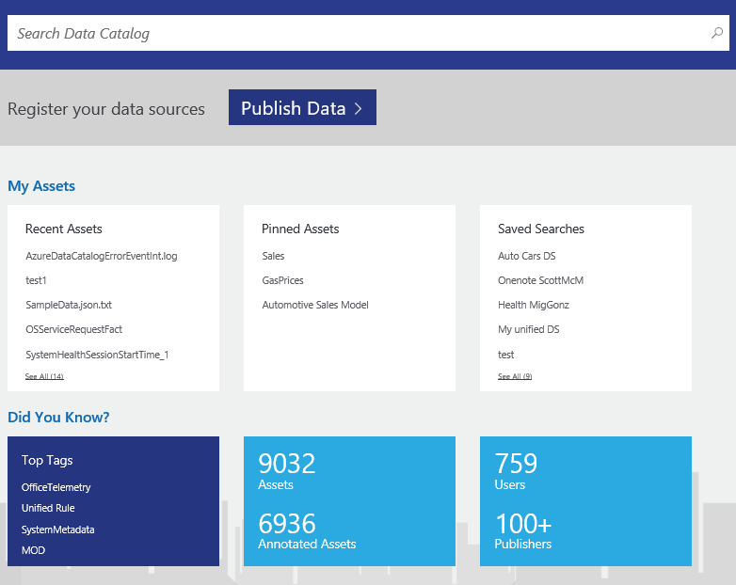
Home Page
Primary action is discovery of datasets with ‘Search’ front and center
Quick jump-offs to recent datasets, pinned assets as well as saved search queries
Quick analytics showing catalog-level usage

Slide 16
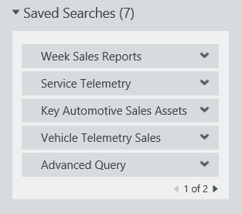
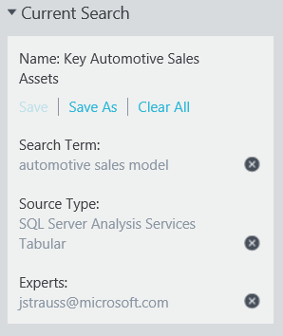
Saved Searches
Define search criteria
Add search terms
Add tags and other filters
Save and name for later reuse
Mark one saved search as default
Running saved search always returns current results
Select from Home page
Select from Discover page
Notes:
https://azure.microsoft.com/en-us/documentation/articles/data-catalog-how-to-save-pin/

Slide 17
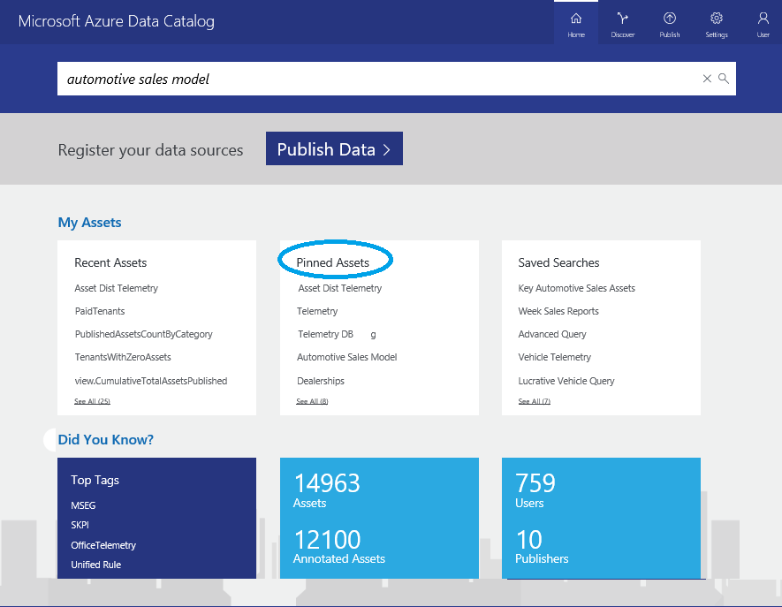
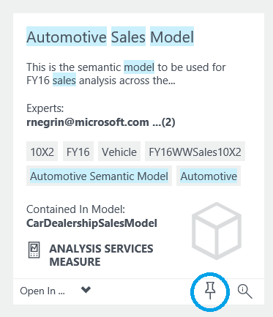
Pinned Assets
Pin frequently-used assets and containers to your home page
Pin and unpin data assets from Discover page
View, use, and manage pinned data assets from Home page
Notes:
https://azure.microsoft.com/en-us/documentation/articles/data-catalog-how-to-save-pin/

Slide 18
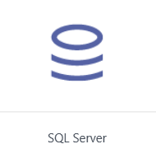
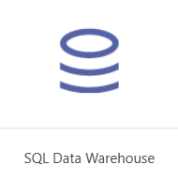
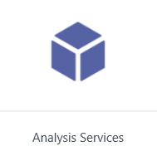
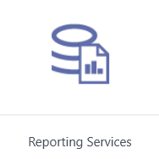
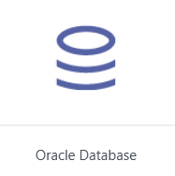
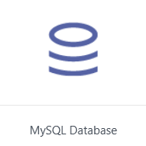
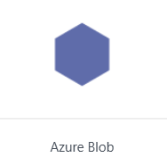
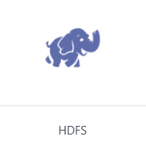

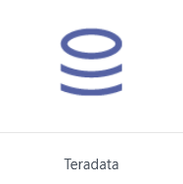
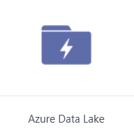
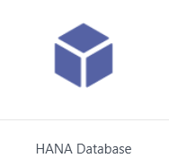
Data Sources
Supported for automatic metadata extraction

Slide 19
Supported Data Sources
Supported via manual entry
Additional Data Sources supported via manual entry
PostgreSQL
OData
SharePoint
HTTP
File System
DB2

Slide 20
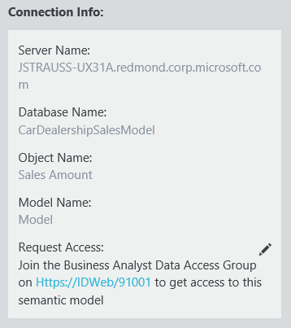

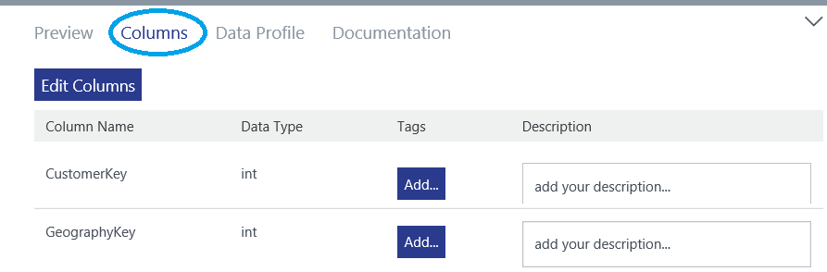
Annotations – Technical Metadata
Technical metadata
Automatically extracted from data sources during registration
Manually entered in Data Catalog portal
Data source location – information needed to connect
Object names and types
Attribute names and types
Data types and related details

Slide 21
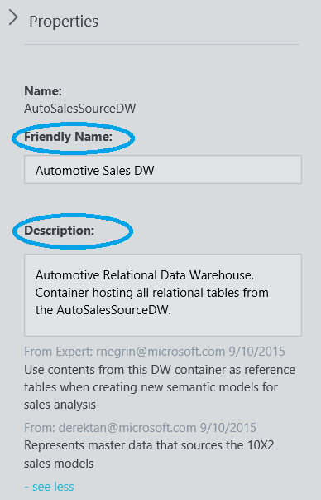

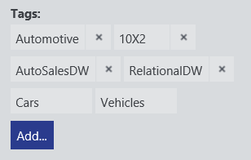
Annotations – Business Metadata
Business metadata
Supplement automatically extracted metadata with business knowledge
Manually entered in Data Catalog portal
Friendly name
Descriptions
Tags
Experts
Object-level and attribute-level information

Slide 22
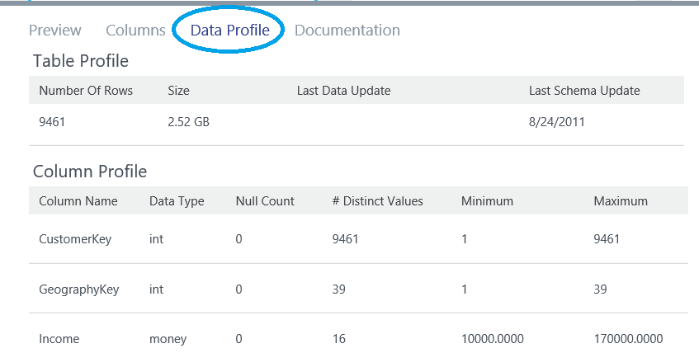
Data Profiling
Data profile statistics for supported data sources
SQL Server, including Azure SQL DB and SQL DW
Oracle
Teradata
Hive
Selected during data source registration
Object-level profile
Size
Row count
Attribute-level profile
Min, max, average, and standard deviation
Null count and distinct value count

Slide 23
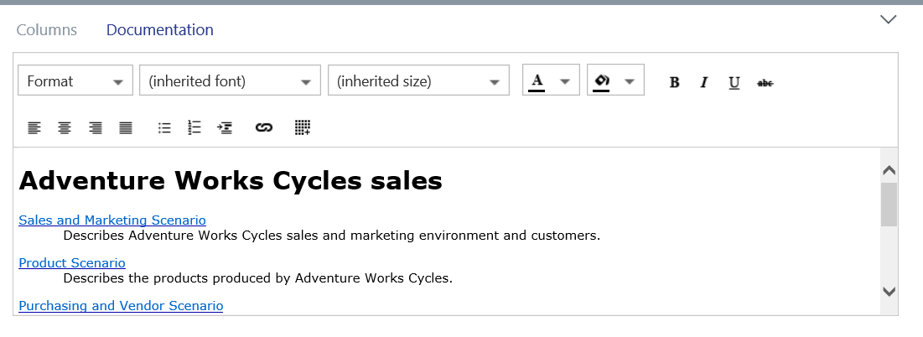
Asset Documentation
Rich text documentation for data assets and containers
Entered via Data Catalog portal
Complements descriptions, tags, and other descriptive metadata

Slide 24
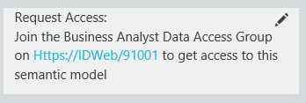
Request Access
Unblock users who discover data assets
Integrate in with existing tools and processes
Include instructions inline with connection info
Link to individuals or teams who manage data source access
Link to existing process documentation
Link to self-service identity management tools like Forefront Identity Manager

Slide 25
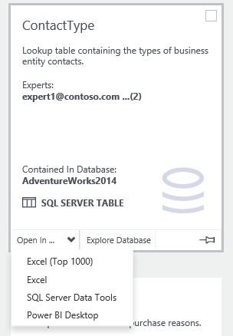
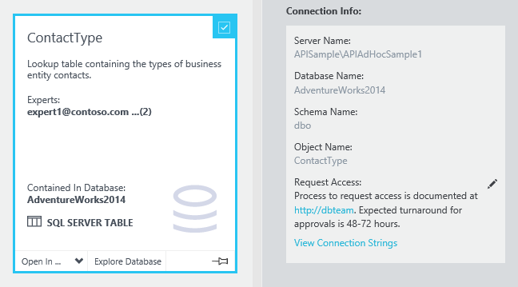
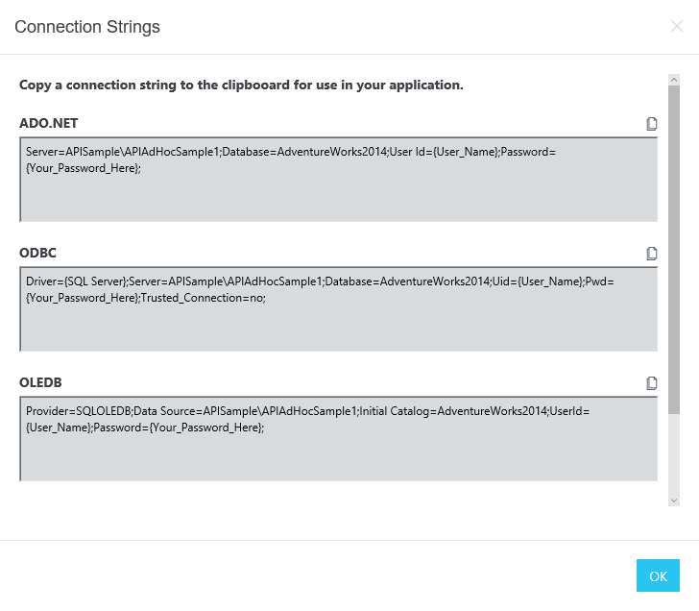
Contextual Asset Consumption
Users can open selected data assets in supported client applications
Data asset properties include complete connection information for use in any client application
Pre-built connection strings are available for data developers

Slide 26
Data Catalog Free Edition
Enroll any number of users in your organization and get started using the free edition
Enjoy a full end-to-end experience of using the Azure Data Catalog service
Allow any user to register, enrich, understand, discover, and consume data from sources registered with the Data Catalog
→ The Free Edition is an open system, where any asset registered is visible to every authenticated user
$

Slide 27
Data Catalog Paid Edition
Scale the Enterprise with Increased Data Governance using Paid Edition
Allow users to take ownership of registered assets for greater control
Enable asset-level authorization restricting visibility and ability to annotate registered assets to a limited number of users as needed
The Paid Edition is a governed system, providing central control and IT oversight
$
Notes:
Paid Edition Capabilities include:
Taking ownership of an asset
Asset-level authorization
Business Glossary

Slide 28
API
REST based API using JSON payload
Allows Registration, Update, and Delete of assets
Allows Create, Update, Delete of annotations
Allows Rich search syntax
Full-text search and exact match
cross asset or scoped to a property
Notes:
Samples: https://azure.microsoft.com/documentation/articles/data-catalog-samples/
Next in depth session:
Bulk register and annotate
Bulk register data assets from an Excel workbook using Data Catalog REST API and Open XML.
Import/Export tool
Use the Data Catalog REST API to fetch assets from the Azure Data Catalog and serialize them into a file.
How to take a set of assets serialized as JSON and push them into the catalog. It supports exporting a subset of the catalog using a search query.

Slide 29
Q&A

